Slide 1
Encore
Counting Application
ELECTION COMMISSION OF INDIA

Slide 2
Infra Requirement
Dedicated Computer, Printer, Scanner, and Stationery availability for each RO.
Redundant IT system for each RO.
Dedicated 8MBPS leased line for counting center with fixed IP address for each computer.
Backup 8MBPS leased line with Internet connectivity from different service provider.

Slide 3
Infra requirement (Contd..)
8 Hrs or more Generator Power Backup
Online UPS with sufficient backup and surge protection
Disabling all USB ports and drives except Printers
Installation of Updated antivirus with current definition
Microsoft Office licensed version and patched up
Physical security in Computer rooms
Restricted entry into Computer rooms

Slide 4
Infra requirement (Contd..)
DIO to be responsible for network architecture and operations.
System Admin for computer troubleshooting
Computer operator with a good knowledge of Excel

Slide 5
Important
Counting On 24th Oct
Data Entry at https://Encore.eci.gov.in/
Support at https://support.ecitech.in/
Demo https://demo.eci.gov.in

Slide 6
Result Display
Website https://results.eci.gov.in/
Voter Helpline Mobile App
Auto Scrolling Panels https://resultapi.eci.gov.in

Slide 7
Role of Returning officer
Precheck of counting data.
Create and activate RO- Computer Assistant login(if require)
Round set up
Assign table entries to RO- Computer Assistant and to himself
Enter Table wise EVM votes (assigned for RO), Verify TRV
Verify RDF and declare rounds wise results.
Edit Table wise EVM votes after declaration of round (if case of any correction required)
Finalise EVM votes entry
Enter Postal Votes and finalise
Declare Results

Slide 8
Role of RO- Computer Assistant
Activate Login by setting up Password and PIN.
Enter Table wise EVM votes (assigned to him)
Download and Verify the Votes in Table wise Records of Votes (TRV). for each table.
Edit Table wise entries (if required) before round declaration by RO.
Ensure to follow the procedure and correct entries done in the system.

Slide 9
Step 1- Pre-counting Check up (Date)
Enter the electors data
Male
Female
Others
Total
Verify contesting candidates details
Name in English
Name in Hindi
Address in English
Address in Hindi
Party name in English
Party name in Hindi

Slide 10
Step2: RO Pre-counting Round Setup
Enter the number of Rounds Scheduled for AC
  Enter number of Polling Station of your AC(By default no. of polling stations will come automatically and can be modified)
  Enter number of counting table in Counting hall.
  Round Schedule for AC (By default no. of polling stations will come automatically and can be modified)

Slide 11
Important points for Round Setup
Rounds should be set up a day before counting day.
No. of rounds setup can not be decreased once the counting has started
No. of rounds setup can be increased based on requirement.

Slide 12
Step3: RO Pre-counting User Management
RO has to enter the Table wise data for all rounds. However if RO wants to delegate the work. The additional users can be created named as “RO- Computer assistant”. And assign tables to them.
  Create RO- Computer Assistant: Enter details of RO- Computer Assistant, activate account and set password and PIN
  Assign table: Returning officer need to assign tables to all the counting users including himself.

Slide 13
Important points for RO- Computer Assistant creation and assignment of tables
RO- Computer Assistant should be created well before counting day.
RO has the authority to assign any no. of tables to any RO- Computer Assistant or to himself.
RO to ensure that all tables are assigned either to RO- Computer Assistant or to RO himself and No table should be left unassigned.
Table assignment to be done before starting of counting.

Slide 14
Step 4 - Counting Day Table wise EVM Vote Entry by RO- Computer Assistant/ RO
Enter the Table wise EVM Votes against each candidate.
Download/ Print ‘Table wise Recording of Votes’ (TRV) after completion of each table entry done.
Validate the information of TRV and then Press Submit.
Repeat Step 1 to 3 till completion of Round.

Slide 15
Step 5 - Round declaration by RO
Ensure all table wise EVM votes entry done by RO- Computer Assistant for that round.
View and Print of Tabulating of Trends/ Result and Round Declaration Form (RDF) for each Round completion.
Validate the information of RDF after completion of each round.

Slide 16
Step 6 - Round declaration by RO
Round completion by RO: RO have to confirm that the Round is complete even if there is any table entry pending (in case of evm votes not retrieved).
RO will press “Publish Result” button after data verification.
Results available on Results portal :Once the Round wise result is published by RO. It will be available to citizen through results portal http://results.eci.gov.in/

Slide 17
Important points for Editing of Data
Correction before declaration and publishing of Round data by RO: The user of assigned to that table (RO- Computer Assistant/ RO) can update the data and verify it through TRV
Correction after declaration and publishing of Round data by RO: Only RO can update the data for any table by updating the values , Verifying TRV, RDF and then again need to press the “Publish Round” Button.

Slide 18
Step 7 - Postal Vote Entry by RO
Enter Postal ballot votes including ETPBS
Postal Ballots votes can be edited by end of the day
Enter Rejected Votes

Slide 19
Step 8 - Declaration Of Result by RO
Edit any data discrepancy of RO level, print and sign TRV and submit the edited data.
You can only declare the result upon EVM votes entered for all Polling stations & Postal Votes finalization
Verify Data from physical records, Press EVM Votes and Postal Votes Finalize button.
Result declaration: Enter the Winner Name and declare the Result.
Download 21E & 21 C and upload signed copy in encore(New suvidha)
Generate Form 20 and Verify.

Slide 20
Security Measures
Two Factor authentication - For Login, Password and a 4-digit PIN will be required. PIN is generated upon first login
Session timeout after 10 min of inactivity.
You can Extend the session for further 10 min each time.
After session timeout, if the Network is same, password will not be required and re-login by PIN only.
If the Network IP address changes, then Password and 4-digit PIN both will be required
If concurrent login is attempted, first session will be logged out and PIN and password both need to be entered by the second user.
Send Email notification on concurrent login.

Slide 21
Dry Run on 16th Oct 10 AM to 3 PM
Dry Run on Demo server on 16th Oct
This will be provided with candidate names and party names with demo suffix.
This data is totally internal and only meant for testing
RO must be present during testing and monitor the complete process.
Rounds and tables to be setup with estimated no. rounds and tables required on actual counting day.
Dry run means full drill upto result declaration.
Returning Officer should give a certificate to CEO of having conducted dry run successfully.

Slide 22
Dress rehearsal on 22nd Oct 10 AM to 3PM
This will be conducted on Live server on 22nd Oct.
This will be provided with candidate names and party names with demo suffix.
This data is totally internal and only meant for testing.
RO must be present during testing and monitor the complete process.
Primary Network and Power should be forcefully shut down to test the alternate arrangements
Dry run means full drill upto result declaration.
Returning Officer should give a certificate to CEO of having conducted dry run successfully.

Slide 23
TECHNICAL SUPPORT
Download user Manual from https://support.ecitech.in
Download ECI Trainers mobile number and name for each state
Download one page flyer for counting day
Download this presentation- Should be used as official handbook
Log on to portal for any support and raise a ticket.
Read updated articles on portal for counting.

Slide 24
How to configure Result Panel?
Steps:
Go to URL https://resultapi.eci.gov.in
Login with CEO/DEO/RO mobile number and OTP
Configure based on your requirement
  State assembly election (Haryana/Maharashtra)
  ByPoll (AC/PC)

Slide 25
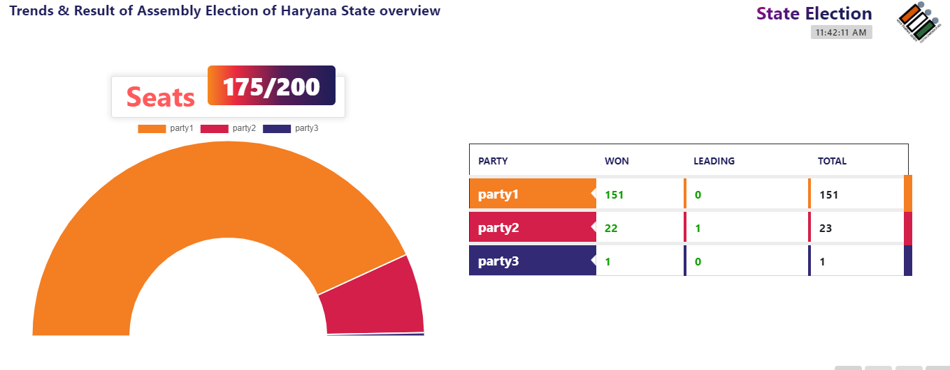
Result Panel Sample

Slide 26
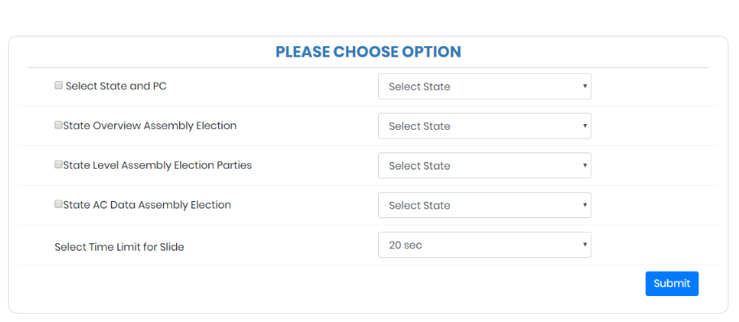
Result Panel Configuration

Slide 27
Thank You

