Slide 1
Revision of Electoral Rolls
Role of Roll Observers

Slide 2
Constitution of India
Article 324- The superintendence, direction and control of the preparation of the electoral rolls for, and the conduct of, all elections to Parliament and to the Legislature of every State and of elections to the offices of President and Vice-President held under this Constitution shall be vested in a Commission.
Article 325- There shall be one general electoral roll for every
territorial constituency for election to either House of Parliament or to the House or either House of the Legislature of a State and no person shall be ineligible for inclusion in any such roll or claim to be included in any special electoral roll for any such constituency on grounds only of religion, race, caste, sex or any of them.

Slide 3
Constitution of India
Article 324- The superintendence, direction and control of the preparation of the electoral rolls for, and the conduct of, all elections to Parliament and to the Legislature of every State and of elections to the offices of President and Vice-President held under this Constitution shall be vested in a Commission.
Article 325- There shall be one general electoral roll for every
territorial constituency for election to either House of Parliament or to the House or either House of the Legislature of a State and no person shall be ineligible for inclusion in any such roll or claim to be included in any special electoral roll for any such constituency on grounds only of religion, race, caste, sex or any of them.

Slide 4
IMPORTANT SECTIONS
Constitution of India-
Article 326- The elections to the House of the People and to the Legislative Assembly of every State shall be on the basis of adult suffrage; that is to say, every person who is a citizen of India and who is not less than 18 [eighteen years] of age on such date as may be fixed in that behalf by or under any law made by the appropriate Legislature and is not otherwise disqualified under this Constitution or any law made by the appropriate Legislature on the ground of non-residence, unsoundness of mind, crime or corrupt or illegal practice, shall be entitled to be registered as a voter at any such election.

Slide 5
Role of Roll Observers
The roll observers are appointed by the ECI to take field visits to assess the quality of roll revision works and to suggest mid course interventions , if any needed during the roll revision time.
All Divisional Commissioners are ER Observers for the ACs comprised within the districts under their jurisdiction. For State/UT without DC system and/or where needed, ECI may also appoint senior officers of the same State or from outside the state as ER Observers.
Roll Observers need to make minimum 3 visits and give report to ECI . The Commission has made standard checklists. Report has to be shared with the CEO of the state who shall take necessary corrective steps , under intimation to the ECI.
As of now, no honorarium is paid to Roll Observers.
During the period of duty, like all the officers and staff deployed for roll revision , they are also deemed to be on deputation to the ECI and subject to discipline and control of the ECI under section 13 CC of the RPA.
If any key election officer such as DEO, ERO /AERO and Roll Observer need be transferred during revision period , ECI’s specific written prior approval is required. In other cases , including BLO, CEO is competent to decide.

Slide 6
Let us understand a few important points of ER Revision

Slide 7
Revision of Rolls- some legal provision
From RPA 1950-
Section 14(2)- defines ‘qualifying date ’as the 1st January of the year in which roll is so prepared or revised.
Section 17 -No person can register in more than one constituency
Section 18 -No person can be registered more than once in any Constituency.
Section 19- Conditions for registration- Every person is entitled for registration if he –
(a) is not less than 18 yrs on qualifying date
(b) is ordinarily resident in that constituency.

Slide 8
Revision of Rolls
Section 21 (1) sec 21(2)-
The roll of each AC shall be revised in the prescribed manner w.r.t. a qualifying date and shall come into force immediately after it’s final publication.
Roll shall be revised before every general /bye election, unless otherwise directed by the ECI for reasons to be recorded in writing.
Proviso to S 21 provides that if the roll is not revised the validity and continued operation of the existing roll shall not be affected.
S 21(3) gives powers to ECI to order , for reasons to be recorded, special revision of a constituency or a part thereof in the manner prescribed by the law.

Slide 9
Procedure during Summary Revision
During Summary Revision:
The schedule for revision exercise is announced by the ECI and needs wide publicity by all possible means of print and electronic media. (Please check for it).
On the day for draft publication , the ERO concerned shall publish the draft electoral roll by making a copy thereof available for inspection and displaying a notice in Form 5 under RER, 1960 at EROs office /if ERO office is not within constituency then at specified place in the constituency. And Further publicity at polling station and such other mode of publicity as may be prescribed, including
Rule 11 and 22 of the RE Rules 1960, Hard Copy (paper copies) of Rolls from ERO office and soft copy (PDF without image) in CD-ROM from CEO office are supplied to recognized political parties.
(Please check for it by verifying its records)

Slide 10
Procedure during Summary Revision
During Summary Revision:
No H2H enumeration is done normally as no de-novo roll is created. But H2H visit of BLOs are done to verify the entries of the existing roll, to collect photos from residual electors, to distribute various forms so as to facilitate registration of “the eligible but left out “ section of the locality assigned to him.
(Please do sample check for BLOs work like whether all BLOs have done visits properly and keeping BLOs registers duly filled up and updated.)

Slide 11
The Forms prescribed under RER are as follows:
S. No. | Form | Rule | Description
1. | Form 1 | Rule 7 | Statement as to place of Ordinary Residence by a Person holding a Declared Office
2. | Form 2 | Rule 7 | Statement as to place of Ordinary Residence by a member of the Armed Forces
3. | Form 2A | Rule 7 | Statement as to place of Ordinary Residence by a member of an armed police force of a State, who is serving outside that State
4 | Form 3 | Rule 7 | Statement as to place of Ordinary Residence by a person employed under the Government of India in a post outside India
5 | Form 4 | Rule 8 | Letter of request to occupants of a dwelling unit.
6 | Form 5 | Rule 10 | Notice of publication of Electoral Roll in Draft
7 | Form 6 | Rule 13(1) and 26 | Application for inclusion of name in Electoral Roll
8 | Form 6 A | Rule 8A | Application for inclusion of name in Electoral Roll by an overseas elector.
9 | Form 7 | Rule 13(2) and 26 | Application for objecting inclusion or seeking deletion of name in Electoral Roll
10 | Form 8 | Rules 13(3) and 26 | Application for correction to particulars entered in Electoral Roll
11 | Form 8A | Rules 13(4) and 26 | Application for transposition of entry in Electoral Roll

Slide 12
The Forms prescribed under RER are as follows:
S.no. | Form | Rule | Description
12 | Form 9 | Rules 15 and 16 | List of applications for inclusion of names received in Form 6
13 | Form 10 | Rules 15 and 16 | List of applications for objection to inclusion of names received in Form 7
14 | Form 11 | Rules 15 and 16 | List of applications for objection to particulars in entries in Electoral Roll received in Form 8
15 | Form 11A | Rule 15 and 16 | List of applications for objection to particulars in entries in Electoral Roll received in Form 8 A
16 | Form 12 | Rule 19(1)(b)(i) | Notice of hearing of a claim
17 | Form 13 | Rule 19(1)(b)(ii) | Notice to the objector
18 | Form 14 | Rule 19(1)(b)(ii) | Notice to the person in respect of whom objection has been made
19 | Form 15 | Rule 19(1)(b)(iii) | Notice of hearing of an objection to particulars of an entry in the E. Roll
20 | Form 16 | Rule 22(1) | Notice of final publication of Electoral Roll

Slide 13
Mandatory Pre-Revision activities
The Commission has prescribed an extensive list of pre–revision activities which, interalia, includes the following -
Running of de-duplication software on the ER database of a constituency or a group of constituencies. It throws out the list of possible duplicates, which need to be verified by a BLO or a verifying official and the name of the elector is retained at the place where he/she is found ordinarily living and deleted , either on Form 7 or suo-motu by the ERO concerned ( using powers u/s 22 of the RPA 1950 or Rule 21A of RER 1960. Proper notice to an elector , before deleting name is mandatory , under law. (Please check for it by verifying its records)
Running of Error detecting software- It gives out a list of various type of errors ( 17 types) in the ER which require consequential remedial measures by the ERO. (Please check for it by verifying its records)

Slide 14
Procedure during Summary Revision
( Please note that names added, deleted, or corrected after last final publication and till draft publication i.e. continuous updating period, will form a supplement and it shall also be published along with draft roll. In an election year all existing supplements are integrated before draft publication. In a non- election year, unless otherwise permitted by the ECI, integration is not done. Also in an election year, unless special permitted, suo-motu deletions of names from a roll shall not be done. Instead, ASD ( Absent, shifted (with family linkage and without family linkage) and dead electors lists are prepared.)
Rationalization of polling stations- This has to be done in accordance with the ECI recent guidelines, No bifurcation of a section is permitted while retagging electors during rationalization./creation of auxiliary polling stations. (Please check for it by verifying its records)
Control tables updation- Most crucial activity. If the control tables are not updated , the address and other details of the elector/EPIC will be erroneous. The quality and accuracy of GIS mapping of polling stations on Google map will also be poor. (Please check for it and obtain a certificate from the concerned officer)

Slide 15
Procedure during Summary Revision
Following more things to facilitate public be done . Adequate publicity must .
Search facility by name as well as by EPIC number to be provided on CEOs website. Further SMS query search using EPIC number. Also offline search also to be made available in ward offices in city areas. Call centre with toll free number 1950 be made operational. (Please check for it)
On line registration facility has to be provided in CEOs website. (Please check for it. Also ascertain status and reason for undue delay in disposal)
A well thought out district SVEEP action plan with partner agencies like schools/colleges, Govt agencies, NSS,NYKS, DD and AIR CSOs and other similar bodies/agencies . (Please check for it and obtain figure s of each activity planned such as creative hoardings, media advertisements, rallies etc. )
A campaign called “Know your BLO” has to be organized at each locality. (Please check for it)

Slide 16
Procedure during Summary Revision
Detailed pre revision interaction with RWAs and such NGOs/CSOs working for better electoral roll and inclusive democracy . Role of BLAs and BLVs to be clarified.
To cover the gap of 18-19 years age group , special and focussed interactions with school /college principals. (Please check whether a teacher has been made a nodal officer for this purpose. Assess the impact of this intervention.)
The Commission has devised statistical tools i.e. Format 1-VIII to check the fidelity and health of the roll of a particular State/district/AC or a PS . The inputs are analyzed so that suitable strategies can be made at different level to address a particular issue like low/high EP ratio, gender ratio, youth registration, PER and EPIC etc. The CEO does the analysis at State level and DEOs are required to do it at district/AC level . Areas needing special focus must be determined well in advance and targets set accordingly. It is always advisable to study previous years data also to find out any hidden trend (Please check for it.)

Slide 17
Before draft publication DEO/ ERO has to ensure
No roll revision related post including BLOs/BLO supervisors is lying vacant.
Proper analysis of Formats 1-8 done at district/AC level and targets to address deviations/shortfalls made with appropriate strategy.
The roll is reorganized according to rationalized polling stations. Draft roll has all components of the electoral roll . AC/PS map ( nazri naksha) should be updated and each new section should start from a new page. There should be no blank section.
If the supplements have not been integrated , ensure that draft roll contains all supplements.
That the names of MPs and MLAs are present in the rolls and also the removal of names of disqualified persons. Also advisable to check for names of prominent personalities in district/AC.
Adequate number of copies of draft roll, both hard copy and soft copies are available.

Slide 18
All related Forms /Statements etc are available in sufficient numbers.
The ERMS software is fully operational
Updated list of BLAs appointed by recognized political parties is available. BLAs, once appointed by a party continues as BLAs unless their appointment is revoked/modified by the party. BLAs are authorized to collect copy of electoral roll of their concerned part/s on behalf of the party. The rolls of only such parts of which no BLA has been appointed by party shall be given to that recognized parties required under Rule 11(c)
Draft publication is done for last part. (i.e. service voters) also.
(Please check for all the above said points.)

Slide 19
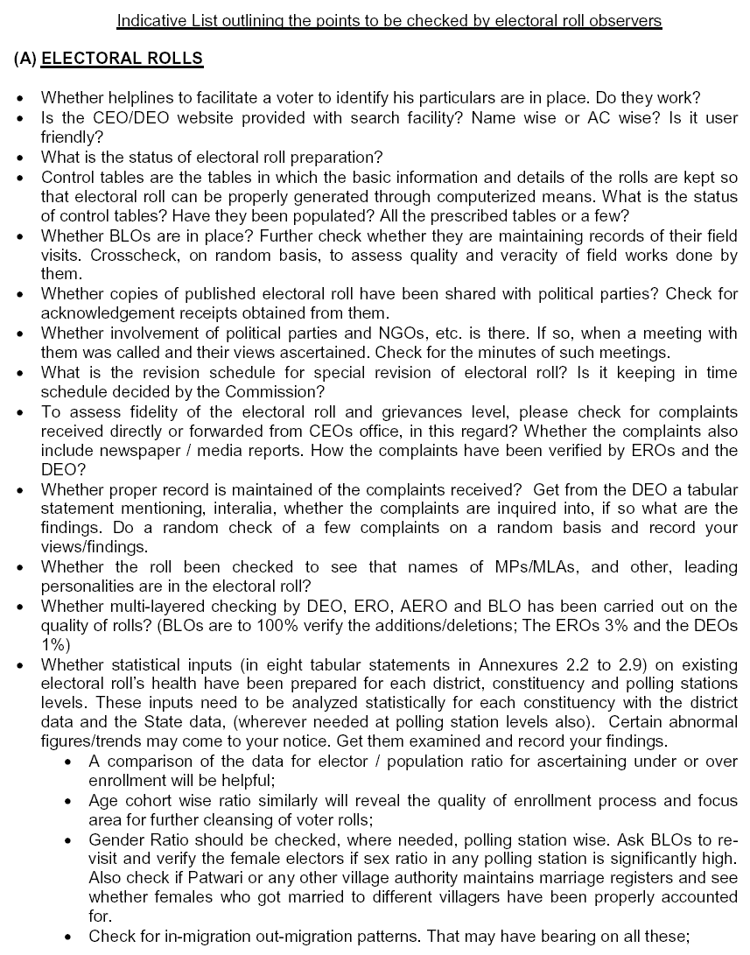
Where do Roll Observers fit in ?
Senior IAS officers are appointed by ECI under provisions of Article 324 of Constitution of India as Roll Observers.
Visits deputed to specific areas to field-verify the Electoral Rolls on random basis
Report to ECI on the quality of the Electoral Rolls.
Responsible to report as per checklist of ECI. They may add any point needing ECI urgent attention. ( Please refer HB of ERO)
Sample Checklist

Slide 20
Duties of EROs during Roll Revision ( The list is illustrative and not exhaustive)
ERO is responsible for:
Drawing a detailed plan of action for completion of revision as directed by ECI
Procuring different types of Forms and Stationery
Identifying and selecting various functionaries like BLO, Designated Officer etc.
Preparing and providing training for BLOs and Designated Officers by Master trainers
Publishing Draft Roll by making a copy of Roll available for inspection
Publicizing notice in Form 5
Supplying copies of Draft Roll to recognized political Parties in the State
Calling for a meeting of political parties to request their suggestion or corrections on published Roll
Maintaining list of received Forms 6,7,8 and 8A in format 9,10,11 and 11A
Conducting enquiry about claims & objections
Issuing notices for hearing of claims and objections cases
Reviewing and monitoring the quality of work of AEROs, Supervisors, DOs and BLOs
Including names inadvertently omitted or deleted
Publishing Final Roll after incorporating the decisions and inaccuracies after written prior approval of the ECI. Final publication to be done strictly in accordance with ECI instruction number …….
Supplying to recognized political parties a copy of complete electoral roll with supplements.
Analysis of formats 1-8 before draft and final publication.

Slide 21
What does the Roll look like?
Advise for facilitator
Please use real ER of one AC and few parts to explain the details given in next few slides

Slide 22
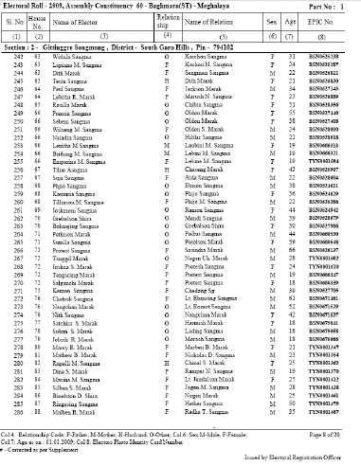
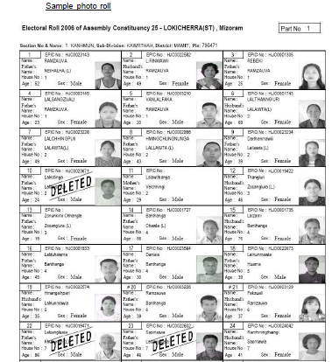
Electoral Roll
Every constituency electoral roll is divided into a number of parts . In each part there are more than one section.
The Text roll is now converted into photo electoral roll. Text rolls are now a thing of past.
Text Roll
Photo Electoral Roll

Slide 23
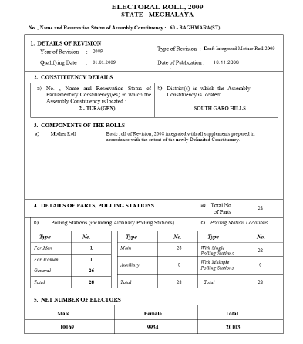
Components
Assembly Constituency of
the State of Meghalaya
ACTitle Page
The AC Title page has :
Details of the concerned Assembly constituency
Clearly demarcated Nazari map of that assembly constituency on the back of the title page
Details of the parts of the AC

Slide 24
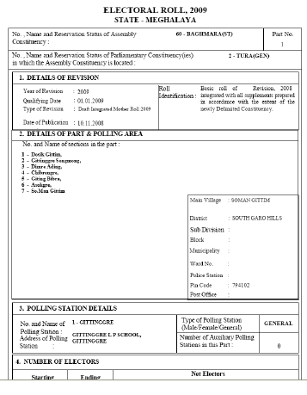
Part Header Page
Like AC header page , part page Header has:
details of the concerned part area.
clearly demarcated Nazari map of that part area on the back of it.
Part Areas of
the state of Meghalaya
Details of the sections of the part

Slide 25
Section pages
A section defines a clearly identifiable area/locality within that polling station area. No maximum/minimum limit( as many as needed).
Every new section should start from a new page
A section page has:
name of the section on the top of the page
details related to the concerned assemble constituency
list of electors arranged house number wise of every section starting with one and goes horizontally
details of electors with photo
Every section should begin with a new page
Details of the sections
Details of the assembly
House numbers
Electors details

Slide 26
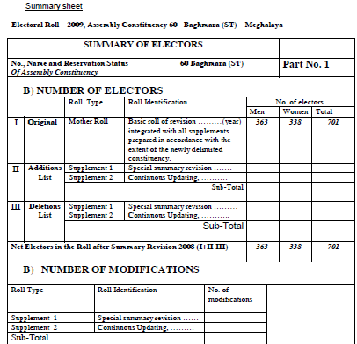
Summary of Electors
Supplement
A Supplement page has:
List of names added, deleted , corrected and transposed , in the draft roll.
Addition list starting with last serial number of the mother roll
Deletion list with no changes in the serial number and the part header
One or more supplements can be attached with mother roll due to several revisions.
Even if no name added/deleted etc, the supplement shall be prepared indicating NIL.
Addition List
Deletion List

Slide 27
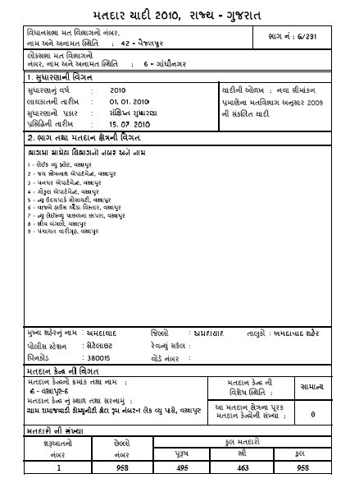
Name of PC
Name of AC
Mother Roll
It is the roll created after intensive revision and/ or published as draft roll during subsequent revisions.
Any addition, deletion or changes are reflected in the supplement roll of that year.
There is provision for integration of all the supplements before the roll is published as draft .In an election year all supplements shall be integrated before draft publication. In other years integration of the supplements with written prior approval of the ECI.
Details of AC

Slide 28
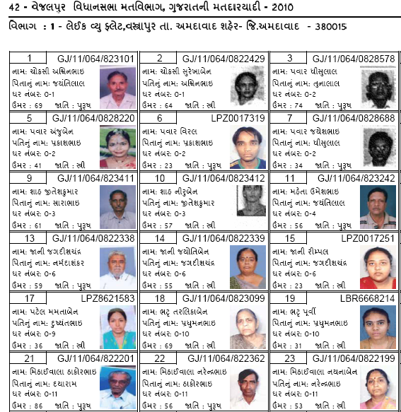
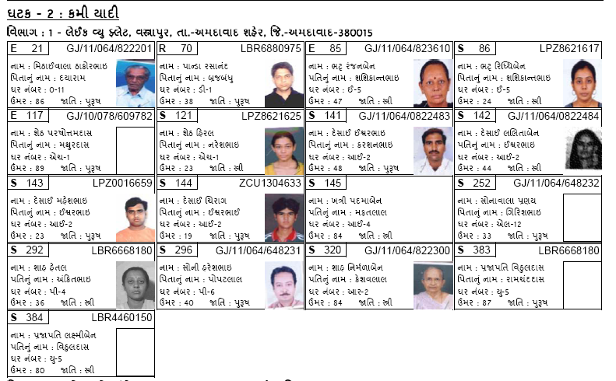
Sample 1 – Change due to deletion
Mother Roll
Supplement

Slide 29
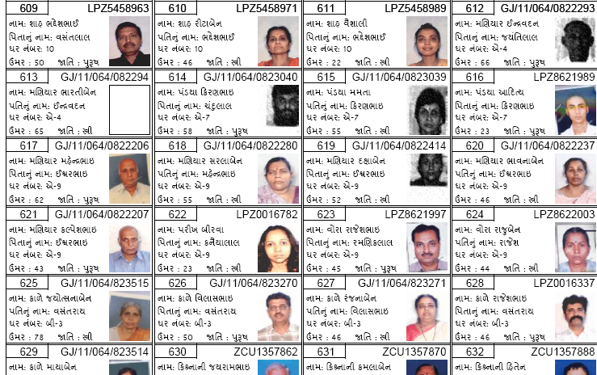
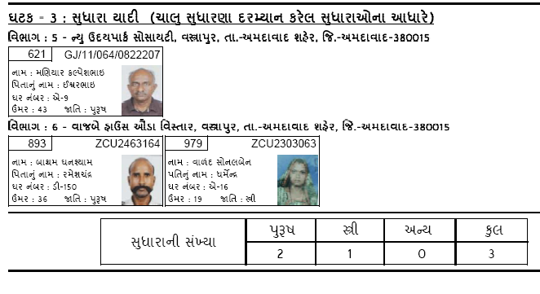
Sample 2 – Change due to correction (Incorrect photo)
Entry in
Mother Roll
Entry in Supplement
– for change

Slide 30
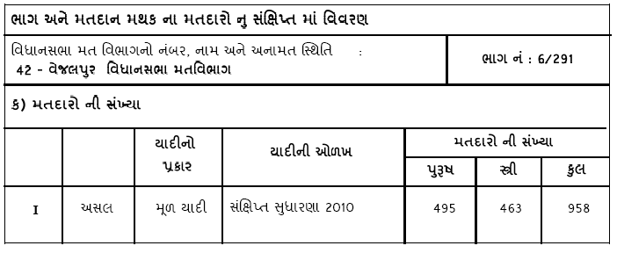
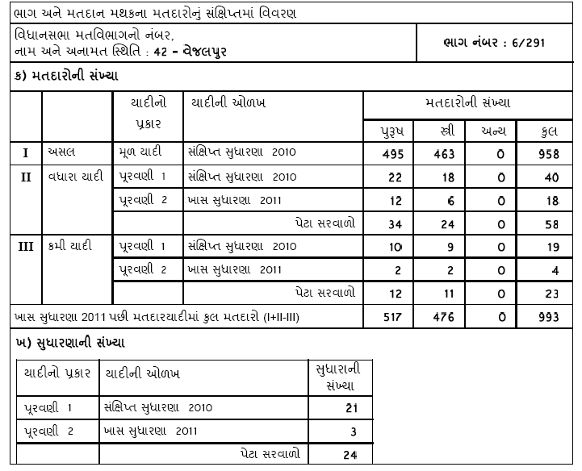
Changes in the total number of the entries
Entry in
Mother Roll
Entry in
Supplement

Slide 31
How Roll revision is done

Slide 32
General Introduction to Roll Revision
Roll Revision
Presently, the Commission orders summary revision of the rolls with special campaign dates and issue detailed guidelines. Please refer it
ERO Role towards Roll revision process:
ERO has to a statutory responsibility to revise the roll and keep it updated in the light of various legal provisions and ECI guidelines. Some of the key functions are-
notify the roll revision program in Form 5 (appended in RER, 1960) and publish the draft roll at his office and all designated locations. Before that all pre revision activities must be over.
Further publicize widely through advertisements, CEO's website etc.
provide minimum 15 and maximum 30 days for filing claims and objections (under rule 12 RER, 1960)
Ensuring digitalization of all forms as an ERMS activity. Drill down lists of all C&O on portal. Further that lists in forms 9 to 11A are made and displayed at PS and at his office.
not accept any application after the last date/specified time period announced
inquire the claims / objections of all Forms 6,7,8,8A (under Rule 20 of RER,1960). Hold hearing where ever needed.
ERO can suo-moto include/delete names which may have been inadvertently deleted/added respectively after following due procedure

Slide 33
Filing of Claims and Objections
Claims and Objections during Revision
Can be presented by an eligible person for himself and/or for members of his family. Bulk applications not to be accepted.
ECI has recently permitted BLA to file C&Os in bulk with a limit of 10 in a day . No such concession available to RWA, BLVs or CSOs etc. The ERO/AERO shall do a special checking if more than 30 forms are filed during entire period of filing C&Os.
Online filing of C&Os is also available.
Preliminary checking by BLO/DOs at the time of filing. Receipt has to be given. No refusal to accept forms ,if incomplete, even after pointing out the same to applicant.
Summary of C&Os received to be prepared ( in forms 9,10,11 and 11A) by DOs/BLOs and to be displayed at the designated location and copies to ERO.
ERO shall get all forms digitalized first , so that drill down lists can be made available at portal.
All claims and objections received within stipulated time have to be disposed of in a manner prescribed under law.
ECI instructions provide for sample checking of disposals by DEO(1%), ERO(5%) and AER(O(10%). Further where BLAs have filed more than 30 applications for a PS , all such need be personally verified by the ERO/AERO.
This is not correct
Notes:
Facilitator asks each person to say one point in support of the topic

Slide 34
Forms of Claims and Objections
Any claims and objection from general public , which is not in the prescribed format , or unsigned or filed after period of filing C&Os shall be rejected .
Form 6 – Inclusion of name (Service personnel desirous of getting name enrolled as general elector should also attach “Form of declaration”)
Form 6A – Inclusion of name of overseas electors.
Form 7 – Objection/seeking deletion of name( Can be filed by any elector of the roll of the AC )
Form 8 – Correction to a particular entry (Can be filed by the concerned elector only)
Form 8A – Transposition of a name from one Part to another Part of the same AC
Notes:
Facilitator asks each person to say one point in support of the topic

Slide 35
All forms, shall first be digitalized, even before giving to BLO for verification, if needed. An auto-generated SMS/email, if details given in the form, will go to the applicant with unique application ID number.
Thereafter, the ERO should dispose of the forms in accordance with the statutory provisions and ECI guidelines.
Simultaneously , he has to follow the protocol/ all steps for ERMS entry.
The ECI has given the direction that 7 days statutory notice period shall be considered to commence from the date , the following 3 things are done-
Drill down list with clickable form, is available in the CEOs portal
A hard copy of the same is provided to all recognized political party.
A list of all C&Os is displayed at the notice board of the ERO/AERO.
BLO is just a verifying official who should not give any comment whether the C&O should be accepted or not. It is statutory function of the ERO/AERO , which should be taken, having considered, the BLOs report, other facts/evidence produced before him, during hearing, if any held.
Notes:
Facilitator asks each person to say one point in support of the topic

Slide 36
Display of list of claims and objections
List of all claims and objections received should be put up on the website of CEO so that anybody including political parties and candidates are able to see this list and lodge objections with the concerned ERO.
In addition to this-
i. Adequate publicity should be given by CEO to the fact that list of claims and objections is available on his/her website and objections can be raised before the EROs based on this list.
ii. CEO, all DEOs and all EROs should hold meetings with political parties and inform them about the publication of list of claims and objections on CEO's website and the latest instructions of the Commission about disposal of claims and objections.
iii. Political parties should be informed in writing by the CEO/DEO/ERO about publication of list of claims and objections on CEO's website.

Slide 37
Hard copy of the aforesaid list of claims and objections should be made available by ERO to all political parties every week beginning from the period for filing C&Os. The ERO should call a meeting of all recognized political parties and personally handover to their authorized representatives a list of claims and objections received till that date and obtain acknowledgement receipt for the same. This practice should continue till the period for filing C&Os is over. It is further clarified that names included in the list once given, need not be included in the next list. In other words, the list should be incremental and not cumulative. The lists shall simultaneously be displayed polling station wise on the website of the CEO, notice board of the ERO and at the polling stations.

Slide 38
Decision on Claims and Objections
Decision on claims and objections should be taken only after all of the following has been done-
At least seven clear day’s period has passed after list of claims and objections has been published on all of the following -
(1) Website of CEO as clickable lists for each polling station.
(2) Notice board of ERO (in forms 9, 10, 11 and 11A of R.E. Rules, 1960).
(3) Notice board of polling station (in forms 9, 10, 11 and 11A of R.E. Rules, 1960)
(4) A personal notice has been served on the person whose name is proposed to be deleted in cases other than death cases.
ii. At least seven clear days have passed after ERO has given the list of claims and objections to political parties as mentioned above.
iii. All deletions which are done for reason of death shall be made only after ascertaining the facts to the satisfaction of ERO

Slide 39
Preliminary work for Final publication
Get prior approval of the Commission to publish Final Roll
Take into the
considerations the
views and output of
the roll observers
15
Submission of explanatory memoranda to ECI for any abnormality
13
PUBLISH Final Roll
16
14
Do the analysis of
the data to assess
how far the targets
of revision have
been achieved.
In case new EPICs/R-EPICs are to be made, the same should be generated from the ERMS modules
10
11
12
9
Entry of electors’ data in the prescribed formats 1-8.
Do not wait for disposal of all C&Os , continue with supplement preparation of individual Part
Get each supplements thoroughly verified and checked to ensure that each entry is correct and correctly spelt as per form submitted.
All security protocols of ERMS must be observed.
7
Supplements of Parts without amendments, should provide “nil” information.
8
6
5
2
3
Without waiting
disposal of C&Os of
all parts , start preparing
Supplement of a part ( using
ERMS) as soon as
disposal in r/o that part is over
1
Pl ensure that all
required data entry
in AI ER monitoring
module has been
done.
4
Dispose all claims and objections received within prescribed period
Notes:
When the trainer reaches ‘9’ s/he can tell that one can publish the Final Roll but should check the points given from 11 to 15

Slide 40
What is BLO Register?
- To be maintained by Booth Level Officer - Is printed part-wise - IS THE BASIC DOCUMENT FROM WHERE ALL ACTION RELATING to DRAFT ROLLS 2012 FLOWS

Slide 41
WHAT IS BLO REGISTER
BLO REGISTER COMPRISES OF THREE PARTS :
First Part has some Basic Information
There are two annexure
ANNEXURE-I
This is for confirming the existing entries of electors in the roll.
The BLO makes corrections thereof if required
In addition- birth date, number of years of stay and tel no. are taken

Slide 42
ANNEXURE-II
IT HAS THREE PARTS
Newly developed areas / societies / apartments etc. to be located and entered by the BLO.
2. Newly arrived in that part and newly eligible electors and other electors left out in the electoral rolls to be identified
3. Population and gender ratio of that part

Slide 43
What does the BLO register look like ?
Note -To have a clear idea , real and model BLO registers being used in the state has to be shown during training .

Slide 44
THE RECORD TO BE SUBMITTED BY BLO AFTER THE HOUSE-TO-HOUSE VERIFICATION
BLO REGISTER
FORM-6, FORM-7,FORM-8, FORM 8A ALONG WITH NECESSARY EVIDENCE & MANUSCRIPT
THE PRE PRINTED RECEIPTS ALONG WITH COLLECTED PHOTOGRAPHS
LIST OF RESIDUAL PER/EPIC AND ACTION TAKEN TO MAXIMISE IT
LIST OF EXPIRED/SHIFTED/REPEATED and ACTION TAKEN
LIST OF ELIGIBLE PERSONS YET TO FILL FORMS/ENROLL
STATEMENT OF STATISTICAL INFORMATION OF POPULATION/GENDER/AGE COHORT IN THE PART

Slide 45
BLO Register has been given again
The new register is based on draft rolls
The BLO is now expected to do house to house verification for the following purposes only :
Enquire each case of E/S/R and take action as per procedure
Maximise PER/EPIC to almost 100%
Deduplicate
Enroll all 18+ and others left out
Check on similar numbers for EPIC
Check all new construction sites that are populated for enrollment

Slide 46
All BLOs have also been instructed to leave a letter regarding their visit in all houses found locked during this H2H visit

Slide 47
Maximising PER/EPIC Application/receipts we give while collecting photos

Slide 48
Statistical tools to analyze the roll .
Objective- To assess the gaps and contradictions and make suitable strategies to meet the gaps.

Slide 49
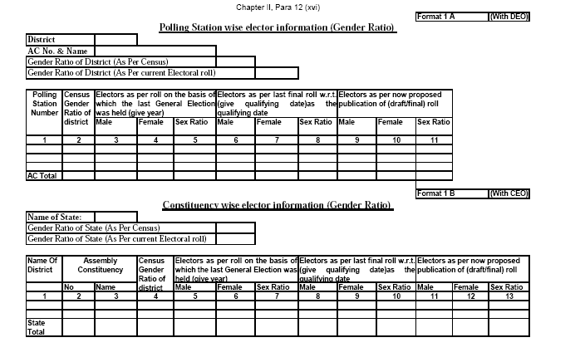
Draft Roll in Summary Revision- Statistical Analysis
Providing elector information in requisite formats
Polling Station wise elector information (Gender Ratio)

Slide 50
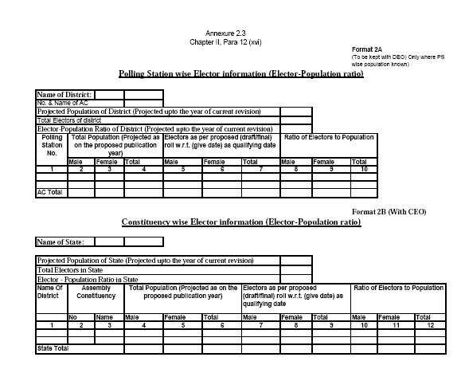
Draft Roll in Summary Revision- Statistical Analysis
Providing elector information in requisite formats
Annexure 2.3 Polling Station wise Elector information (Elector-Population ratio)

Slide 51
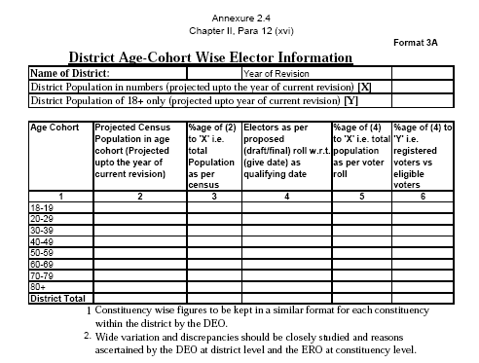
Statistical Analysis
Providing elector information in requisite formats
District wise Age-Cohort Elector Information
Format 3A

Slide 52
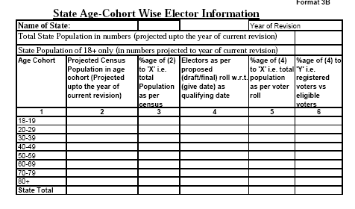
Statistical Analysis
Providing elector information in requisite formats
District wise Age-Cohort Elector Information
Format 3B

Slide 53
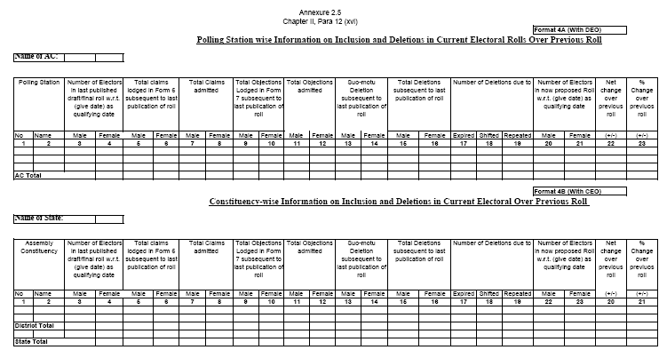
Statistical Analysis
Providing elector information in requisite formats
Polling Station wise Information on Inclusion and Deletions in Current Electoral Rolls Over Previous Roll

Slide 54
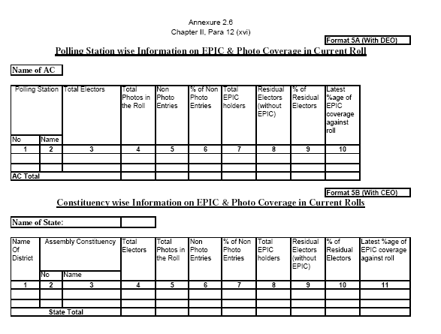
Statistical Analysis
Providing elector information in requisite formats
Polling Station wise Information on EPIC & Photo Coverage in Current Roll
Format 5A and 5B

Slide 55
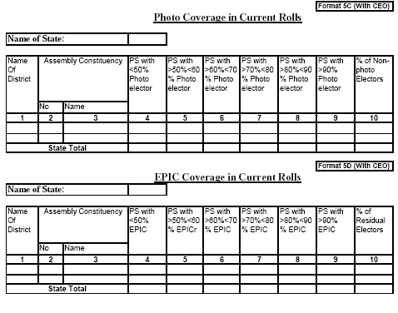
Statistical Analysis
Providing elector information in requisite formats
Polling Station wise Information on EPIC & Photo Coverage in Current Roll
Format 5C and 5D

Slide 56
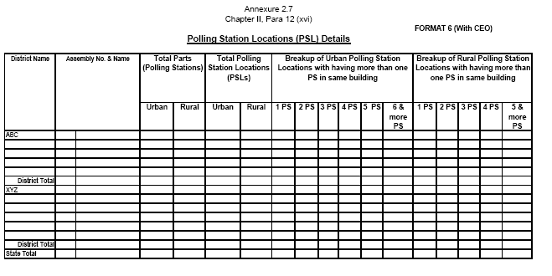
Statistical Analysis
Providing elector information in requisite formats
Polling Station Locations (PSL) Details

Slide 57
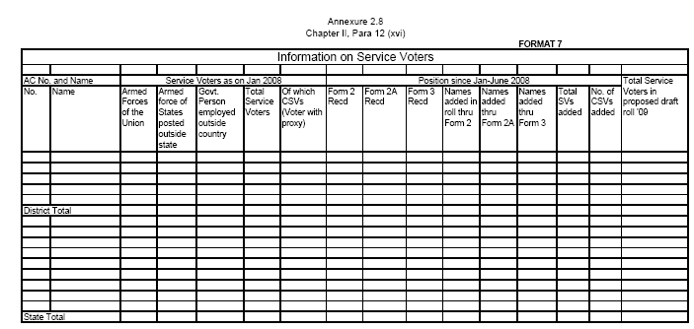
Statistical Analysis
Providing elector information in requisite formats
Annexure 2.8 - Information on Service Voters

Slide 58
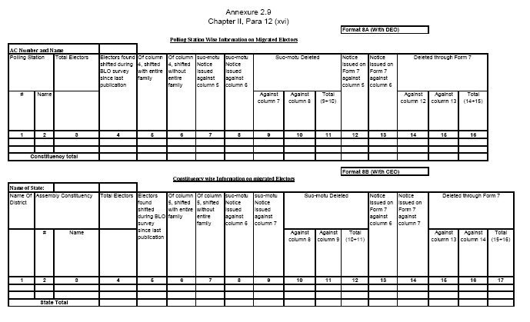
Statistical Analysis
Providing elector information in requisite formats
Annexure 2.9 -Polling Station Wise and Constituency wise information on Migrated Electors

Slide 59
Other directions of ECI
Visit Polling stations of AC/meet voters
Fix a time/place for meeting public during visit
Send detailed report on all points in checklist to ECI through CEO
Go through all relevant instructions of ECI reg Roll revision and NVD celebration

Slide 60
Please be careful about
Large scale rejections without due procedure
Bulk acceptance of forms
Leave/absence of BLOs/SOs/AEROs/EROs
Lack of knowledge on the part of the District and AC officials
Complaints must be addressed
No claims/objections can be left pending at the end of revision period

Slide 61
THANK YOU

