Slide 1
EVP Process at NVSP, ERONet & BLONET APP

Slide 2
Registration on NVSP
Registration
OTP
Active User

Slide 3
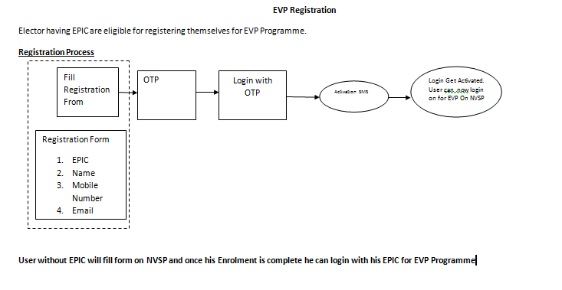
EVP Registration

Slide 4
Verifying Self Details

Slide 5
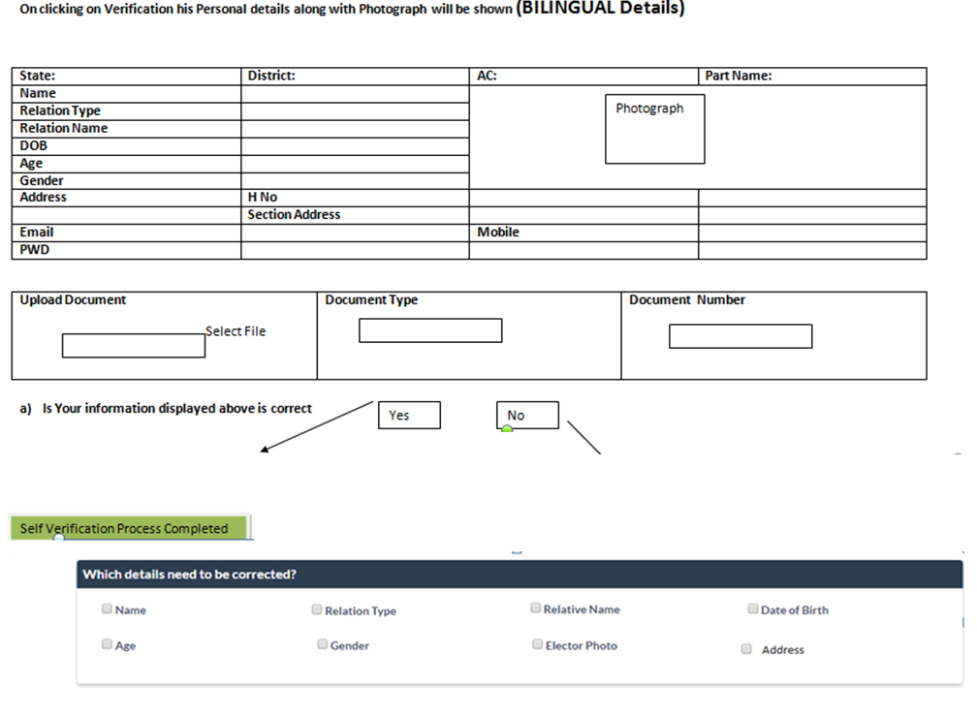
Verification Process
I verify that details of my entry in ER are correct and I authenticate my entry by submitting above document.

Slide 6
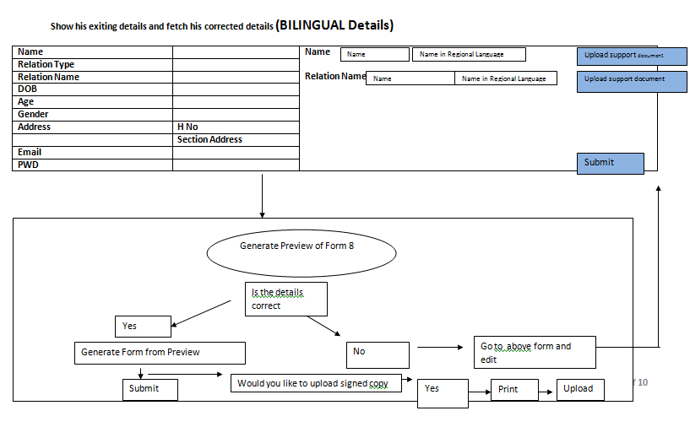
Show elector’s existing details and fetch their corrected details (BILINGUAL Details)

Slide 7
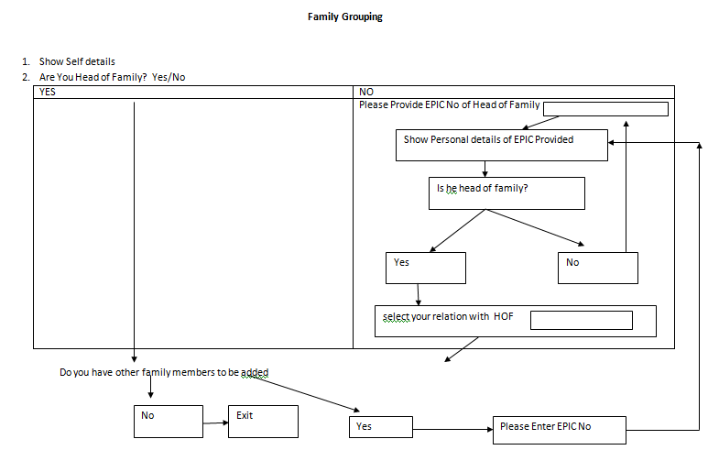
Family Grouping

Slide 8
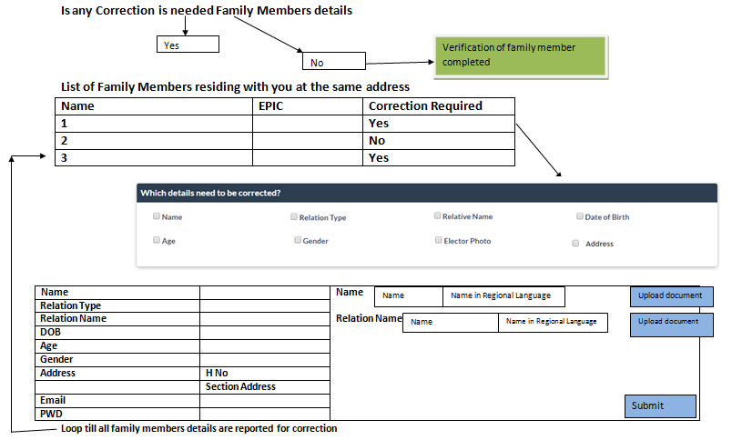

Slide 9
Family Verification status

Slide 10
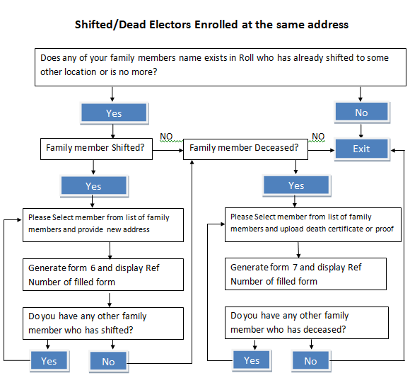
Shifted/ Dead Electors

Slide 11
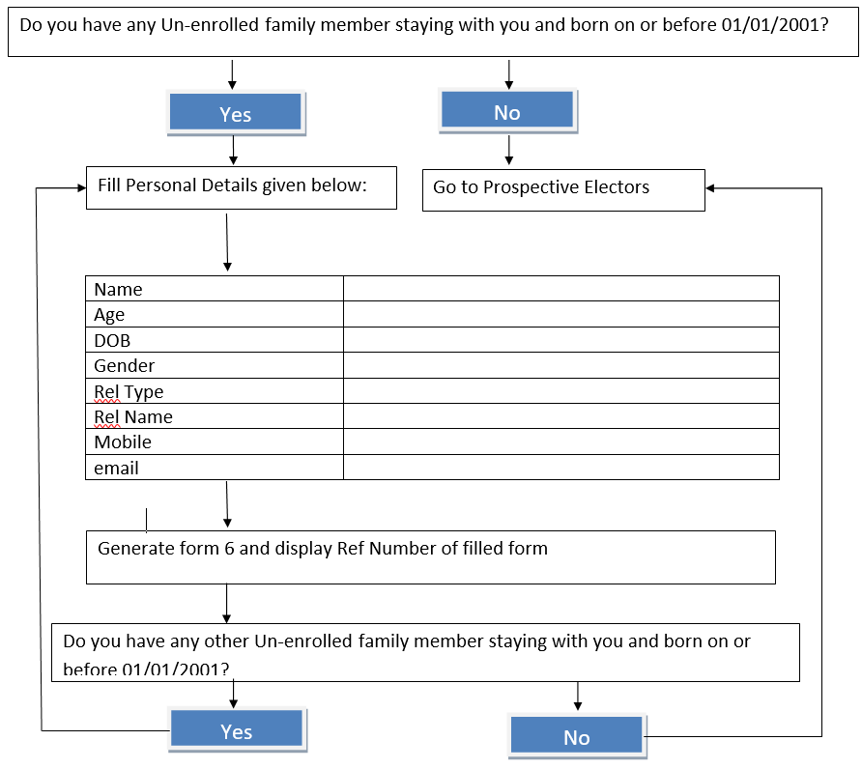
For Unenrolled Citizens

Slide 12
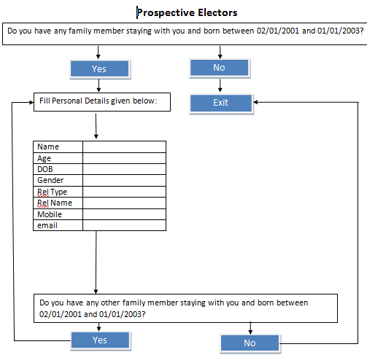
For Prospective Electors

Slide 13
Part Boundary Map
Part boundary maps can be prepared in following ways:
Map of City/Town/Village be taken from respective planning department and parts are marked on it by hand or
Map is prepared using a GIS Tool or
Notional Part Boundary is prepared using IT application. In this a mobile device is used and coordinates are captured by moving around the part

Slide 14
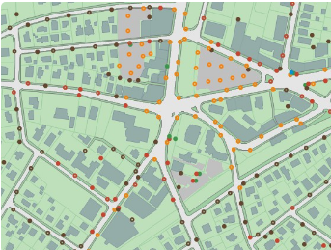
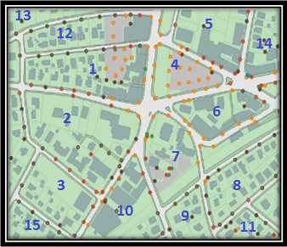
Part Boundary Map
Polygon/PART BOUNDARY
Fig- 1
Fig- 2
We can create different Polygon from groups of points created with a GPS receiver, allowing to create Street/Road/Lane maps, Wing Map, Ward Map and Sector map, Area/Locality map, Village/Town /City and Tehsil maps which helps to identify PART boundaries.

Slide 15
Polling Station Marking
Existing Polling Station is marked on the map by capturing its coordinates using mobile device. Elector can raise concerns about any natural barrier coming while going to polling station.
Information about probable Polling Station can also be provided by elector and its coordinates can be captured by mobile device and marked on Part Boundary Map.

Slide 16
Other Activities
DSE: Processing of leftover DSE by taking appropriate forms
Logical Error Processing of leftover Logical error by taking appropriate forms
Use of PSE (Photo similar entries) in removal of duplicate voters
Standardization of EPIC Number by Correction/Replacement

Slide 17
EVP Process at ERONet
All Self-verified forms form NVSP, Mobile App.
Generate Verification check list
Remaining Elector, who has not verified themselves online
BLO Field verification
Operator Login
ERO Marked the Elector as Verified Elector on UNPER
Verification report Submitted on ERONET along with form reference number (if any)
All details found correct on verification
After Approval, Elector is marked as verified
Form is digitized for further processing
Appropriate Form collected by BLO
Detail not found correct

Slide 18
USER : EVP Home page For Operator login
Select Part
Generate Verification Checklist
Enter BLO Verification Report
Generate Report for ERO
Report on Feedback on Polling Station
ERO Home Page

Slide 19
Operator Verification Checklist generation
EVP Checklist PART NO: 76
Sr No | EPIC No. | Name | Relation Name | Source | Process
 |  |  |  | NVSP | Generate verification list
 |  |  |  | Mobile App | Generate verification list
 |  |  |  | Not Self-Verified | Generate verification list
 |  |  |  | Not Self-Verified | Generate verification list
 |  |  |  | Not Self-Verified | Generate verification list
 |  |  |  | Not Self-Verified | Generate verification list
 |  |  |  | NVSP | Generate verification list
 |  |  |  | NVSP | Generate verification list
 |  |  |  | NVSP | Generated
 |  |  |  | NVSP | Generated
 |  |  |  | Mobile App | Generated
 |  |  |  | Not Self-Verified | Generated
 |  |  |  | Mobile App | Generated
 |  |  |  | Mobile App | Generated
 |  |  |  | Mobile App | Generate verification list
 |  |  |  | Mobile App | Generated
 |  |  |  | Not Self Verified | Generated
 |  |  |  | NVSP | Generated

Slide 20
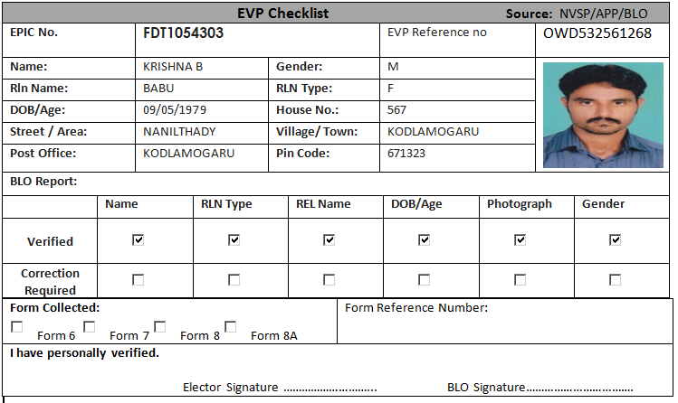
Verification Checklist Format

Slide 21
Verification Checklist Submission (Operator Level)
EVP Checklist Entry process PART NO: 67
Sr No | Name | Relation Name | Source | Process
 |  |  | NVSP | Submit Checklist
 |  |  | Mobile App | Submit Checklist
 |  |  | Not Self-Verified | Submit Checklist
 |  |  | Not Self-Verified | Submit Checklist
 |  |  | Not Self-Verified | Submit Checklist
 |  |  | Not Self-Verified | Submitted
 |  |  | NVSP | Submitted
 |  |  | NVSP | Submitted
 |  |  | NVSP | Submitted
 |  |  | NVSP | Submitted
 |  |  | Mobile App | Submitted
 |  |  | Not Self-Verified | Submit Checklist
 |  |  | Mobile App | Submit Checklist
 |  |  | Mobile App | Submit Checklist
 |  |  | Mobile App | Submit Checklist
 |  |  | Mobile App | Submit Checklist
 |  |  | Not Self Verified | Submit Checklist
 |  |  | NVSP | Submit Checklist

Slide 22
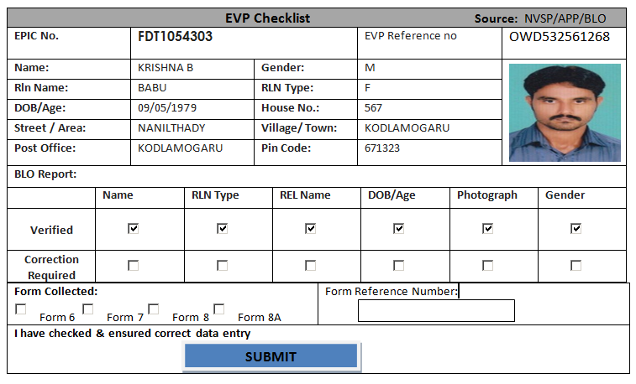
Verification Checklist Submission

Slide 23
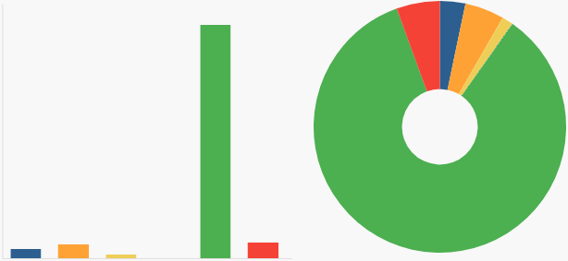
USER : EVP Home page For ERO Login
HIGHLIGHTS
Total Elector’s
Number of request received form NVSP
Number of Request received form Mobile App
Number of Request received form NGSP
Elector Pending for verification
Elector verified by BLO
Elector detail collected & verified by BLO
No. Of form collected
Form 6
Form 6A
Form 7
Form 8
Form 8A
EVP Reports
Process Verified Report
Part Wise Report
EVP Verified List

Slide 24
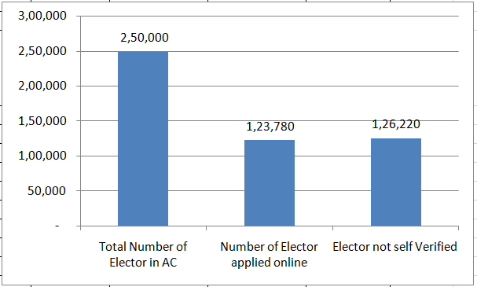
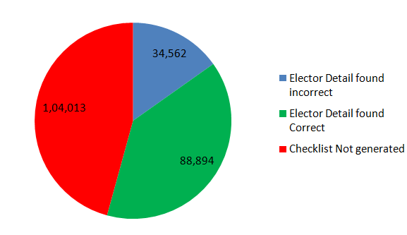
ERO EVP Dashboard ( AC Wise)
Ac Name | Total Number of Elector in AC | Number of Elector applied online | Elector not self Verified | Checklist Generated | Clecklist Submitted | Elector Detail found incorrect | Elector Detail found Correct
Ichchapuram | 2,50,000 | 1,23,780 | 1,26,220 | 1,45,987 | 1,23,456 | 34,562 | 88,894

Slide 25
Polling Station Suggestions report
Polling Station Number | Total Elector | Natural Barrier in reaching Polling Station | Polling station far away | PS Building Infrastructure not Adequate | PS in Private Building | No issue in polling Station
43 | 1365 | 12 | 34 | 23 | 33 | 98

Slide 26
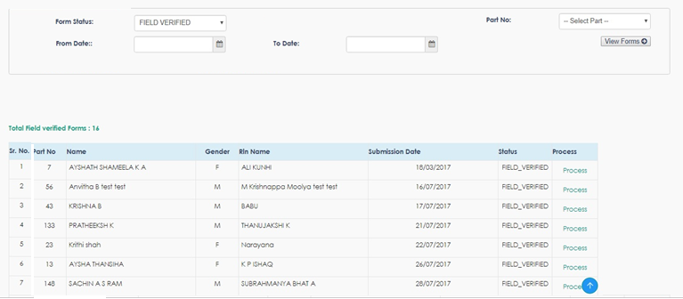
ERO EVP Verification screen

Slide 27
ERO EVP verified list
Verified List
PART NO | Sr No | Name | Relation Name | Source | Status
1 |  |  |  | NVSP | Verified
1 |  |  |  | Mobile App | Verified
1 |  |  |  | Not Self-Verified | Verified
1 |  |  |  | Not Self-Verified | Verified
1 |  |  |  | Not Self-Verified | Verified
1 |  |  |  | Not Self-Verified | Verified
1 |  |  |  | NVSP | Verified
1 |  |  |  | NVSP | Verified
1 |  |  |  | NVSP | Verified
1 |  |  |  | NVSP | Verified
1 |  |  |  | Mobile App | Verified
1 |  |  |  | Not Self-Verified | Verified
1 |  |  |  | Mobile App | Verified
1 |  |  |  | Mobile App | Verified
1 |  |  |  | Mobile App | Verified
1 |  |  |  | Mobile App | Verified
1 |  |  |  | Not Self Verified | Verified
1 |  |  |  | NVSP | Verified

Slide 28
ERO EVP List( Part Wise)
Part Number | Part Name | Total Number of Elector in Part | Number of Elector applied online | Elector not self Verified | Checklist Generated | Clecklist Submitted | Elector Detail found incorrect | Elector Detail found Correct
1 | Muchendra
2 | Kedaripuram
3 | MPUP SCHOOL, KEDARIPURAM (ADDL BUILDING 6 & 7TH CL
4 | Purushottapuram
5 | Purushottapuram
6 | Aminsahebpeta
7 | Mandapalli
8 | MANDAPALLI
9 | Mandapalli
10 | MANDAPALLI
11 | Balakrishnapuram
12 | Munibadra
7 | Mandapalli
8 | MANDAPALLI
9 | Mandapalli
10 | MANDAPALLI
11 | Balakrishnapuram
12 | Munibadra

Slide 29
DEO/CEO/ ECI EVP Dashboard
District Number | District Name | Total Number of Elector in District | Number of Elector applied online | Elector not self Verified | Checklist Generated | Checklist Submitted | Elector Detail found incorrect | Elector Detail found Correct
1 | Srikakulam
2 | Vizianagaram
3 | Visakhapatnam
4 | East Godavari
5 | West Godavari
6 | Krishna
7 | Guntur
8 | Prakasam
9 | Nellore
10 | Kadapa
11 | Kurnool
12 | Anantapur
13 | Chittoor

Slide 30
DEO/CEO/ ECI EVP Dashboard
AC Number | AC Name | Total Number of Elector in AC | Number of Elector applied online | Elector not self Verified | Checklist Generated | Clecklist Submitted | Elector Detail found incorrect | Elector Detail found Correct
1 | Ichchapuram
2 | Palasa
3 | Tekkali
4 | Pathapatnam
5 | Srikakulam
6 | Amadalavalasa
7 | Etcherla
8 | Narasannapeta
9 | Rajam (SC)
10 | Palakonda (ST)

Slide 31
DEO/CEO/ ECI EVP Dashboard
Part Number | State Name | Total Number of Elector in State | Number of Elector applied online | Elector not self Verified | Checklist Generated | Clecklist Submitted | Elector Detail found incorrect | Elector Detail found Correct
1 | S01-Andhra Pradesh
2 | S02-Arunachal Pradesh
3 | S03-Assam
4 | S04-Bihar
5 | S05-Goa
6 | S06-Gujarat
7 | S07-Haryana
8 | S08-Himachal Pradesh
9 | S09-Jammu & Kashmir
10 | S10-Karnataka
11 | S11-Kerala
12 | S12-Madhya Pradesh
13 | S13-Maharashtra
14 | S14-Manipur
15 | S15-Meghalaya

Slide 32
Thanks

