Slide 1
Electors Verification Programme
30/07/2019

Slide 2
Electors Verification Programme
Electors Verification Programme (EVP) in a campaign mode programme in which the citizens will be encouraged to come forward and authenticate existing elector’s details along with their family members.
Following Information of Elector
shall be verified
Name
DoB/Age
RLN Name
RLN Type
Photograph
Gender
2. Electoral roll provides
Left over elector(If any)
Prospective voter
Shifted, dead elector in family
Absent, shifted and dead elector in part (if any)
Information and suggestion on PS
3. Submit respective forms for addition/deletion and correction

Slide 3
Electors Verification Programme
For submitting their details for verification methods used would be
NVSP
Mobile App
1950 (For Senior Citizens and PwD only)
Through BLO
NVSP has been suitably modified
EVP portal is being provided for ERO/DEO/CEO offices to operate.

Slide 4
Electors Verification Programme
Self & Family Verification
The citizens will verify their electoral details through NVSP portal,“Voter helpline” mobile app, or submitting a hard copy of filled up forms through BLOs to EROs by giving copy of one of the following documents:-
Indian Passport
Driving License, or
Aadhar
Ration card
Any other document as approved by the Commission.

Slide 5
Electors Verification Programme
Family Information
Elector will search his family detail by EPIC number on NVSP, Mobile APP & Helpline, and then tagging them together as Family

Slide 6
Electors Verification Programme
Polling Station
Citizen shall be asked for suggestion on following
Natural Barrier in reaching Polling Station
Polling station far away
Polling Station Building Infrastructure not Adequate
Polling Station in Private Building
If PS is not found satisfactory, He will be asked to suggest alternate polling stations.

Slide 7
Role of BLO in EVP
BLO will collect following
Voter verification
Family Information
Suggestions on Polling station & Alternate Polling station
Projected population
Prospective electors
Unenrolled electors

Slide 8
Role of ERO in EVP
ERO
Monitor EVP activities
Approval & marking of verified electors on ERONET through EVP Portal.
Family bundling monitoring
Collate Projected population
Collate Prospective electors
Collate Unenrolled electors
Process Forms received through ERONET

Slide 9
Role of DEO & CEO in EVP
DEO
Monitor ERO EVP activities
Check suggested Polling stations
Update projected population with age cohort
SVEEP activities
CEO
Monitor State EVP activities
Provide Guidance & Decisions required for rollout of EVP
SVEEP activities

Slide 10
Use of GIS in EVP
Citizen
Provide Latitude & Longitude of his/her house
BLO
Part Boundary Preparation
Capture Polling Station Coordinates
Capture Probable Polling Station Coordinates
Improved Maps Preparation
Nazari Naksha (Street name with Section Marking)
Google Map View
Polling Station Building Front View
CAD View (indicating arrangements within polling booth)
Key Map View (with the indication of how to reach )

Slide 11
Part Boundary Map
Part boundary maps can be prepared in following ways:
Map of City/Town/Village be taken from respective planning department and parts are marked on it by hand or
Map is prepared using a GIS Tool or
Notional Part Boundary is prepared using IT application. In this a mobile device is used and coordinates are captured by moving around the part

Slide 12
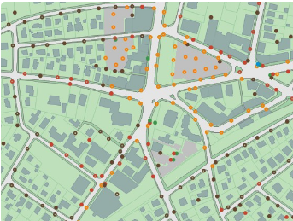
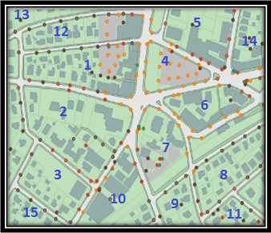
Part Boundary Map
Polygon/PART BOUNDARY
Fig- 1
Fig- 2
We can create different Polygon from groups of points created with a GPS receiver, allowing to create Street/Road/Lane maps, Wing Map, Ward Map and Sector map, Area/Locality map, Village/Town /City and Tehsil maps which helps to identify PART boundaries.

Slide 13
Polling Station Marking
Existing Polling Station is marked on the map by capturing its coordinates using mobile device. Elector can raise concerns about any natural barrier coming while going to polling station.
Information about probable Polling Station can also be provided by elector and its coordinates can be captured by mobile device and marked on Part Boundary Map.

Slide 14
Other Activities
DSE: Processing of leftover DSE by taking appropriate forms
Logical Error Processing of leftover Logical error by taking appropriate forms
Use of PSE (Photo similar entries) in removal of duplicate voters
Standardization of EPIC Number by Correction/Replacement

Slide 15
EVP Process at ERONet
All Self-verified forms form NVSP, Mobile App.
Generate Verification check list
Remaining Elector, who has not verified themselves online
BLO Field verification
Operator Login
ERO Marked the Elector as Verified Elector on UNPER
Verification report Submitted on ERONET along with form reference number (if any)
All details found correct on verification
After Approval, Elector is marked as verified
Form is digitized for further processing
Appropriate Form collected by BLO
Detail not found correct

Slide 16
Information to be collected during SSR- EVP by BLO
Dead Elector
Married Daughter Staying with parents
Verification of elector’s detail collected online
Un enrolled Citizen
Prospective Voter
Shifted Elector
Married Daughter Shifted
Family tagging
Probable Polling Station Details
Absent Elector

Slide 17
Polling Station Suggestion
Elector login to NVSP, Mobile App or call NGRS
Enter EPIC Number and Search for Polling Station
Suggestion sought
Natural Barrier in reaching Polling Station
Polling station far away
PS Building Infrastructure not Adequate
PS in Private Building
No Sugestion
Any Other Location where PS can be established (Suggestion)

Slide 18
Role of Operator
Select Part
Generate Verification Checklist
Enter BLO Verification Report
Generate Report for ERO
Report on Feedback on Polling Station
ERO Home Page

Slide 19
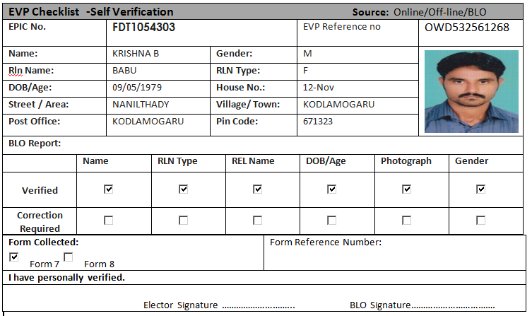
Self verified Checklist

Slide 20
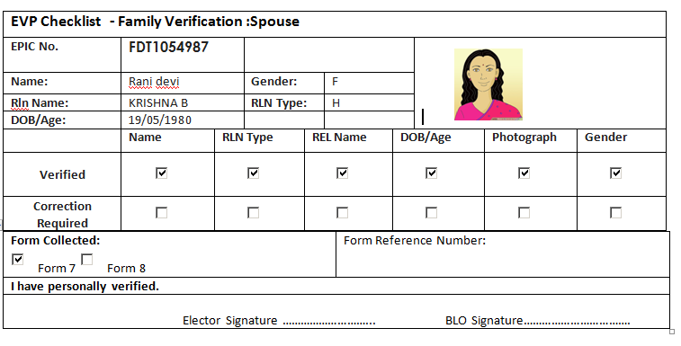
Spouse Verified Checklist

Slide 21
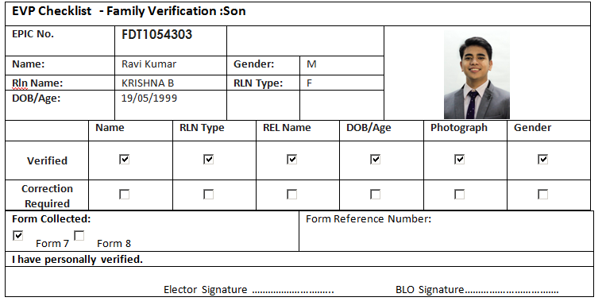
Son/Daughter Verified Checklist

Slide 22
**Similar Dashboard for DEO & CEO shall be shown for Monitoring
ERO Role on EVP
EVP Reports
Process Verified Report
Part Wise Report
EVP Verified List

Slide 23
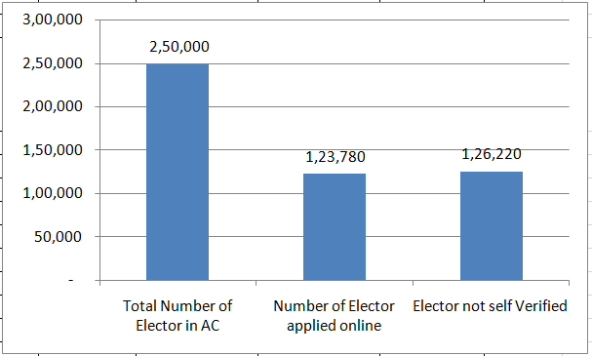
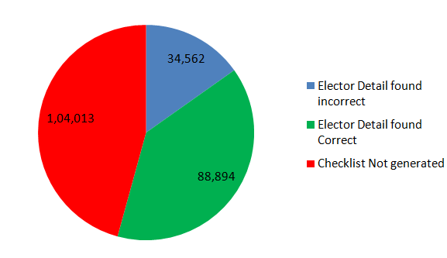
ERO EVP Dashboard ( AC Wise)
Ac Name | Total Number of Elector in AC | Number of Elector applied online | Elector not self Verified | Checklist Generated | Clecklist Submitted | Elector Detail found incorrect | Elector Detail found Correct
Ichchapuram | 2,50,000 | 1,23,780 | 1,26,220 | 1,45,987 | 1,23,456 | 34,562 | 88,894

Slide 24
Polling Station Suggestions report
Polling Station Number | Total Elector | Natural Barrier in reaching Polling Station | Polling station far away | PS Building Infrastructure not Adequate | PS in Private Building | No issue in polling Station
43 | 1365 | 12 | 34 | 23 | 33 | 98

Slide 25
Thanks

